Slide 1
COMP 4332 / RMBI 4310 Big Data Mining (Spring 2021)
Project 1: Sentiment Analysis
TA: Zihao WANG (zwanggc@cse.ust.hk)

Slide 2
Sentiment Analysis
Generally modeled as classification or regression task
predict a binary or ordinal label

Slide 3
Sentiment Analysis
Simplest task:
Is the attitude of this text positive or negative?
More complex:
Rank the attitude of this text from 1 to 5
(3/5) The room was clean and everything worked fine – even the water pressure
(1/5) …the worst hotel I had ever stayed at ...
Advanced:
Detect the target, source, or complex attitude types

Slide 4
Pipeline
Data Loader: Load data from disks
Feature Extraction: Find useful features
Learning: Classification via different classifiers
For more information and examples, please refer to demo.ipynb

Slide 5
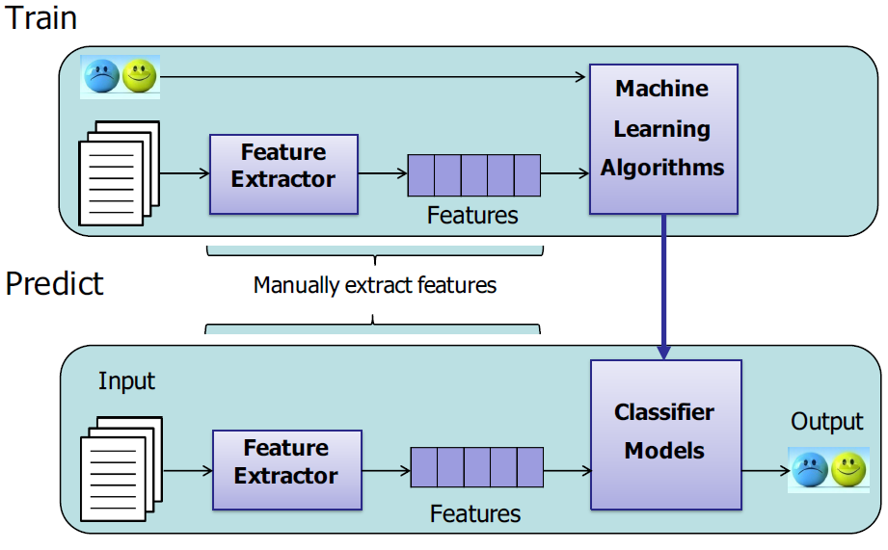
Pipeline

Slide 6
Feature Extraction
word occurrence, word frequency, or TF-IDF
This room is clean.
[0,0,1,1,0,1,0,0,1,0,1]
word embedding
cbow, skip-gram, GloVe, fasttext
contextualized word representation
ELMo, BERT, GPT, GPT-2

Slide 7
Feature Extraction
user information
nationality
age
date
weekday or weekend
holiday?
hotel rating
Hilton Hotel
Youth Hostel
data mining

Slide 8
Classification
Naïve Bayes
Logistic Regression
Support Vector Machine
Deep Learning

Slide 9
Multi Layer Perceptron
activation
Output
Hidden
Input
Demo: http://playground.tensorflow.org/

Slide 10
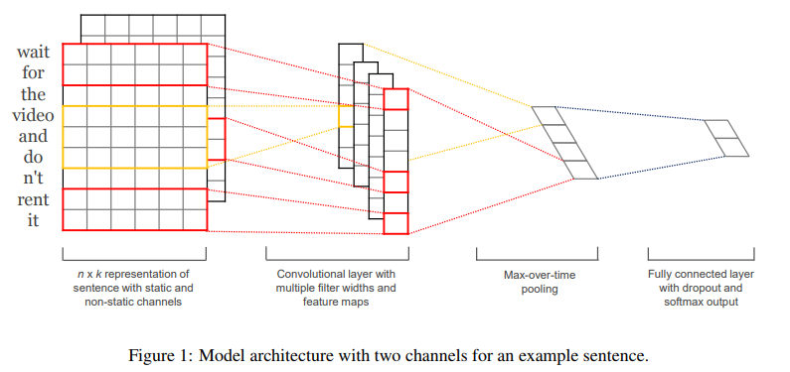
CNN

Slide 11
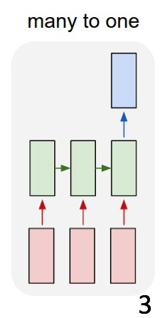
RNN

Slide 12
Dataset
training data: 20000 reviews
validation data: 2000 reviews
test data: 2000 reviews
stars: 1.0-5.0
given features: business_id, cool, date, funny, review_id, text, useful, user_id

Slide 13
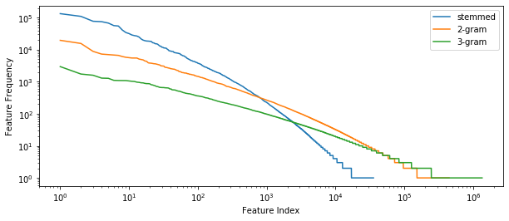
Text Distribution
stemmed feature size: 35531
2-gram feature size: 446252
3-gram feature size: 1345361

Slide 14
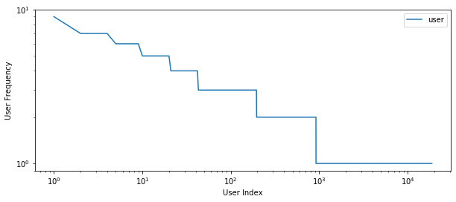
User Distribution
user size: 35531

Slide 15
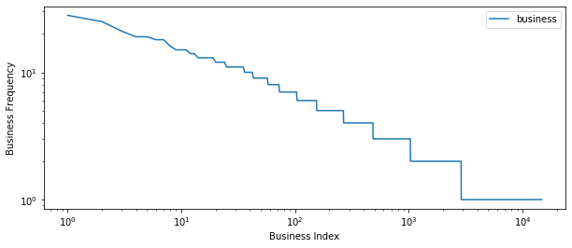
Business Distribution
user size: 14763

Slide 16
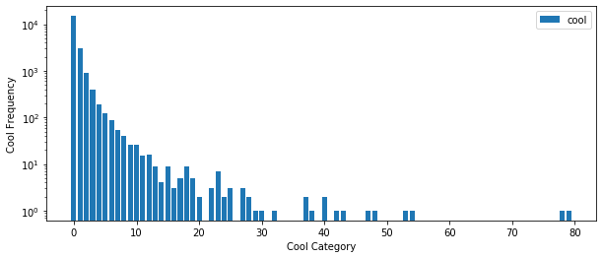
Cool Distribution
user size: 41

Slide 17
More Distributions
You can explore by yourselves.

Slide 18
Evaluation
accuracy on test data

Slide 19
Schedule
Three weeks
[March 16, 2021] Project Start
[March 23, 2021] Release the validation accuracy of weak baseline
[March 30, 2021] Release the validation accuracy of strong baseline
[April 06, 2021, 23: 59] Project due

Slide 20
Submission
Predictions on test data (please make sure you can successfully evaluate your validation predictions on the validation data with the help of evaluate.py)
Report (1~2 pages)
Code (Frameworks and even programming languages are not restricted.)
DDL: April 06, 2021
Submission: Each team leader is required to submit the groupNo.zip file that contains pre.csv, the report, and your team’s code on canvas.
we will check your report with your code and the accuracy on the test set.

Slide 21
Grading Rule
Grade | Classifier (80%) | Report (20%)
50% | example code in tutorials or in Project 1 without any modification | submission
60% | an easy baseline that most students can outperform | algorithm you used
80% | a competitive baseline that about half students can surpass | detailed explanation
90% | a very competitive baseline without any special mechanism | detailed explanation and analysis, such as explorative data analysis, hyperparameters and ablation studies
100% | a very competitive baseline with at least one mechanism | excellent ideas, detailed explanation and solid analysis

Slide 22
Thank You and Good Luck

